Slide 1


TechviFy
SOLID Principles
August -2022​
Created by
Islam Towhidul​

Slide 2
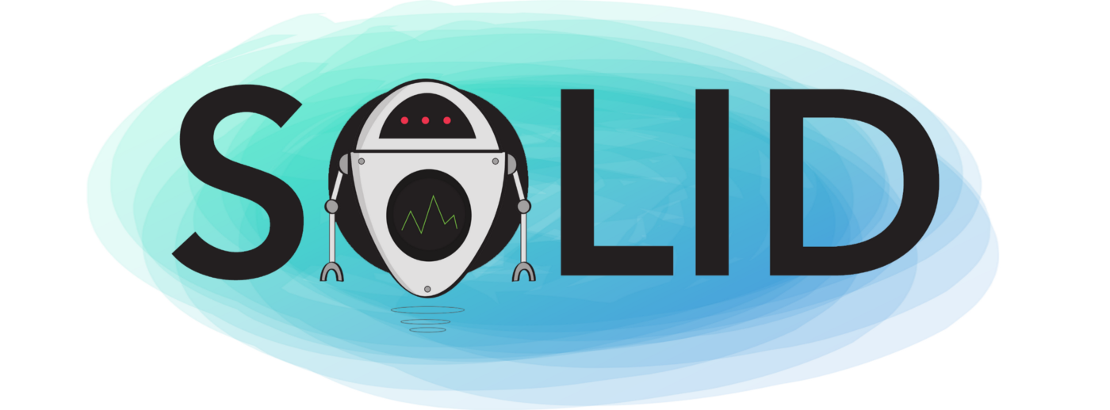
Contents
What is SOLID
Why important SOLID principles
Single Responsibility Principle (SRP)
Open/Closed Principle
Liskov’s Substitution Principle (LSP)
Interface Segregation Principle (ISP)
Dependency Inversion Principle (DIP)

Slide 3
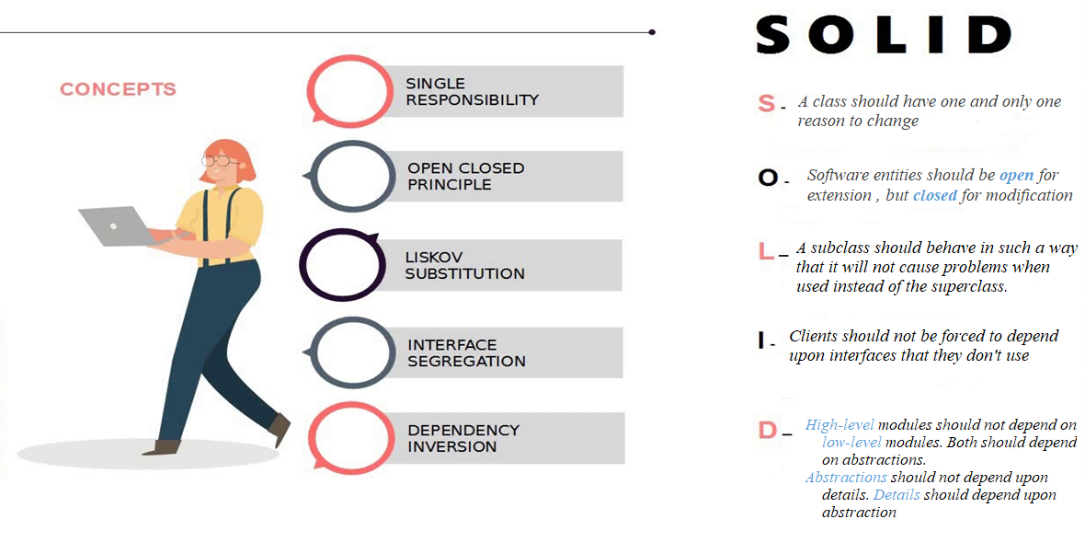
The SOLID principles of Object-Oriented Design include the following 5 principles:

Slide 4


Why important SOLID principles?
The SOLID principles were developed to combat these problematic design patterns. The broad goal of the SOLID principles is to reduce dependencies so that engineers change one area of software without impacting others. Additionally, they're intended to make designs easier to understand, maintain, and extend.

Slide 5
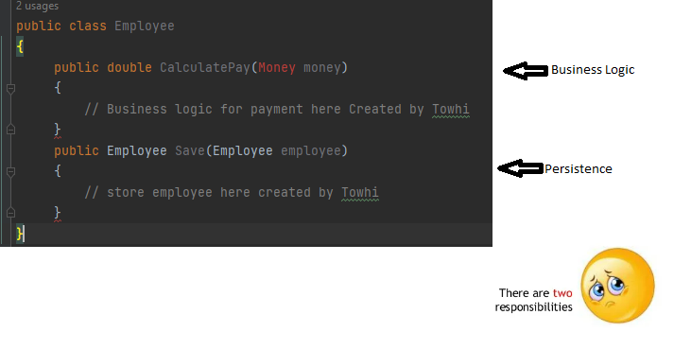
Single Responsibility Principle (SRP)
"A class should have one and only one reason to change"

Slide 6

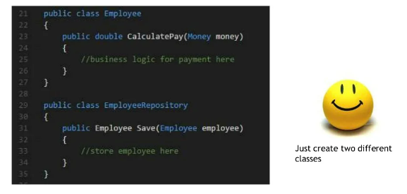
Single Responsibility Principle (SRP)
How to Solve this ?

Slide 7
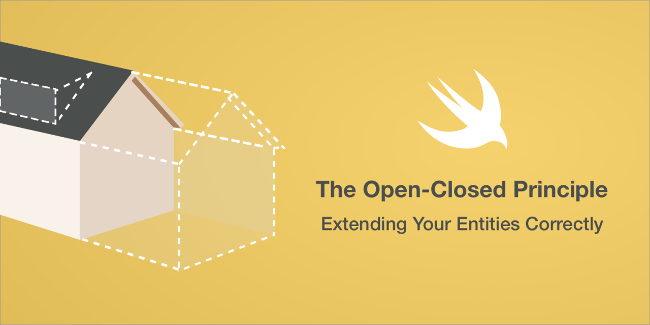
Open/Closed Principle
"Software entities should be open for extension , but closed for modification"

Slide 8
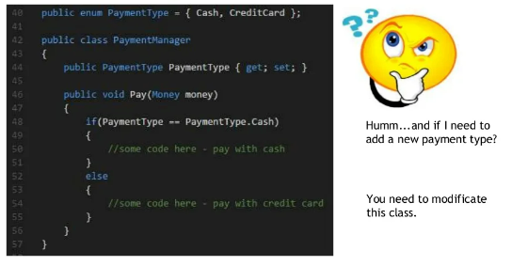
Open/Closed Principle

Slide 9
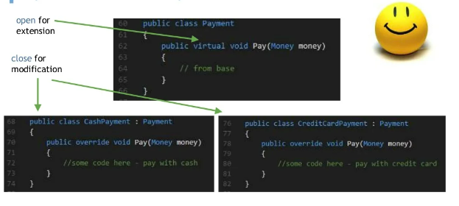
Open/Closed Principle
The inheritance is a good way to apply the OCP; we don’t change the source code of the Payment class. But we introduced coupling between it and the CashPayment and CreditCardPayment class. In a real example, you will use inheritance with concrete classes that have many methods, and sometimes we don’t need this coupling.
What I loved about software engineering is that always there is a better way, 🤗

Slide 10

Liskov’s Substitution Principle (LSP)
"A subclass should behave in such a way that it will not cause problems when used instead of the superclass"

Slide 11
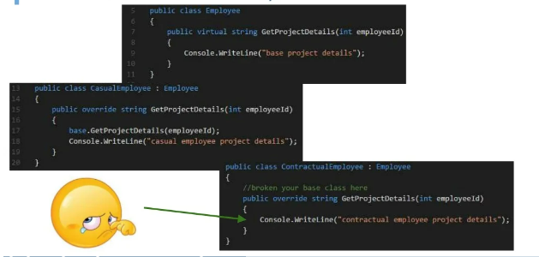
Liskov’s Substitution Principle (LSP)

Slide 12
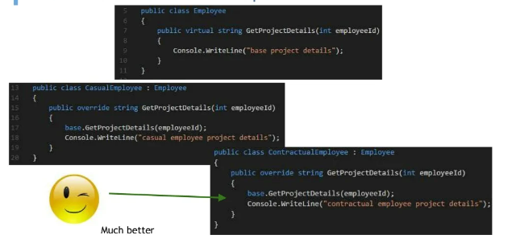
Liskov’s Substitution Principle (LSP)

Slide 13
Liskov’s Substitution Principle (LSP)

Slide 14
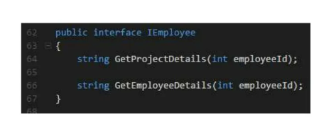
Interface Segregation Principle (ISP)
"Clients should not be forced to depend upon interfaces that they don't use"

Slide 15
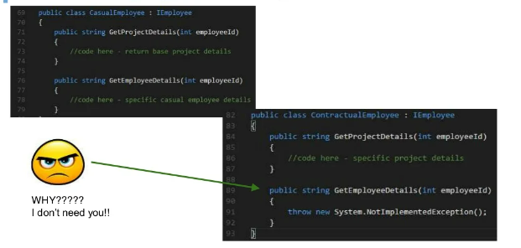
Interface Segregation Principle (ISP)

Slide 16
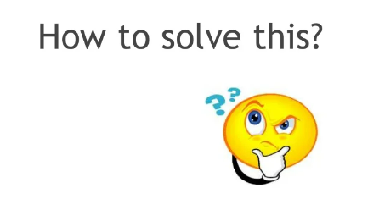
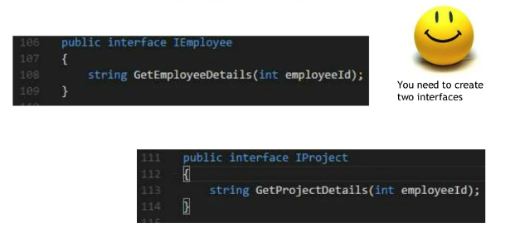
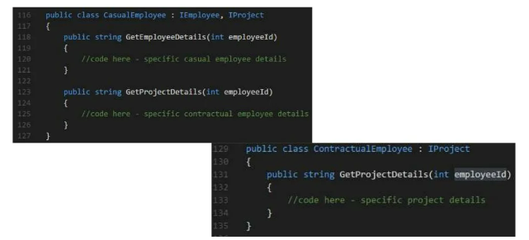
Interface Segregation Principle (ISP)

Slide 17
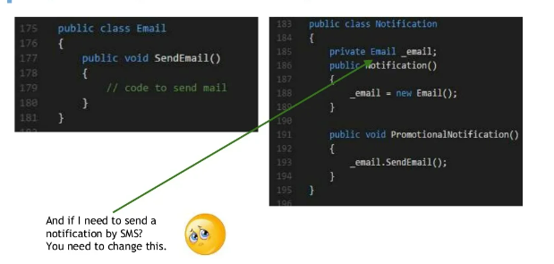
Dependency Inversion Principle (DIP)
"High-level modules should not depend on low-level modules. Both should depend on abstractions."
"Abstractions should not depend upon details. Details should depend upon abstraction"

Slide 18
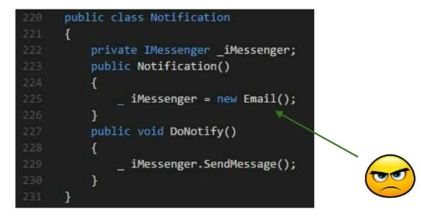
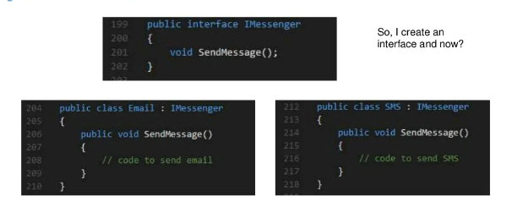
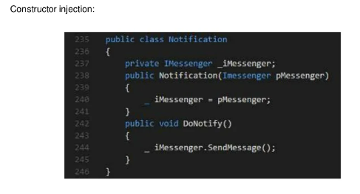
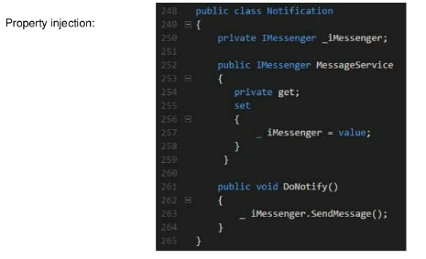
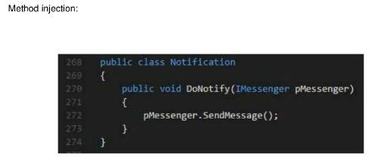
Dependency Inversion Principle (DIP)

Slide 19

Keep in Mind
DRY - Don't repeat yourself
+
SLAP - Single layer abstraction principle
+
SOLID
BEST DEVELOPER

Slide 20
Keep in Mind
Enjoy code and
Keep it simple!

Slide 21

Thank You

